Slide 1

BrachyVision
Team M.A.R.K.
Michael Rees
Ananya Zutshi
Rhea Chitalia
Karthika Raja

Slide 2
Background
– Target Disease: Prostate Cancer
Males
Average age of diagnosis: 70
– In 2014:
-New cases: 233,000
-Deaths: 29,480
-Clinicians: Urologists, Oncologists
Notes:
Prostate cancer: cancer that forms in the tissues of the prostate (- a gland in the male reproductive system: between bladder and rectum)
Can be benign or malignant
can result in metastasis to the bones and lymph nodes

Slide 3
Clinical Need
Current treatment
Surgery, Chemotherapy, Hormone therapy
Radiation: brachytherapy
Brachytherapy
Radioactive seeds implanted into tumor site
Early- localized prostate cancer
Need further imaging to visualize- can’t see it
Excess radiation= bad
Use vibration + ultrasound
Maybe to characterize tissue stiffness to study progression of disease
Notes:
Current Treatments
Surgery: complete removal of the prostate
Cryo-therapy: freezing and killing the prostate tissue
Heating: High intensity focused ultrasound waves to heat and kill the tissue
Chemotherapy: drugs given intravenously through a thin needle
Side effects: cells in hair loose, cells that line the digestive system
Hormone therapy: drugs to prevent testicles from making testosterone
Radiation: brachytherapy - radioactive material placed inside the body into the prostate tumor

Slide 4
Existing Products
Photoacoustic Imaging
Combination of optical imaging and U/S
Sonoelastography
Using U/S to determine tissue stiffness
Pre-operative planning
MRI
Varying pulse sequences
Notes:
Hard to do these in a clinical setting/not low cost

Slide 5
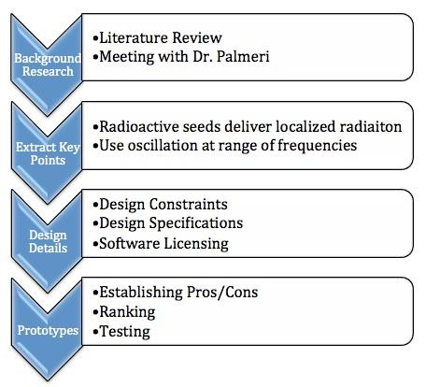
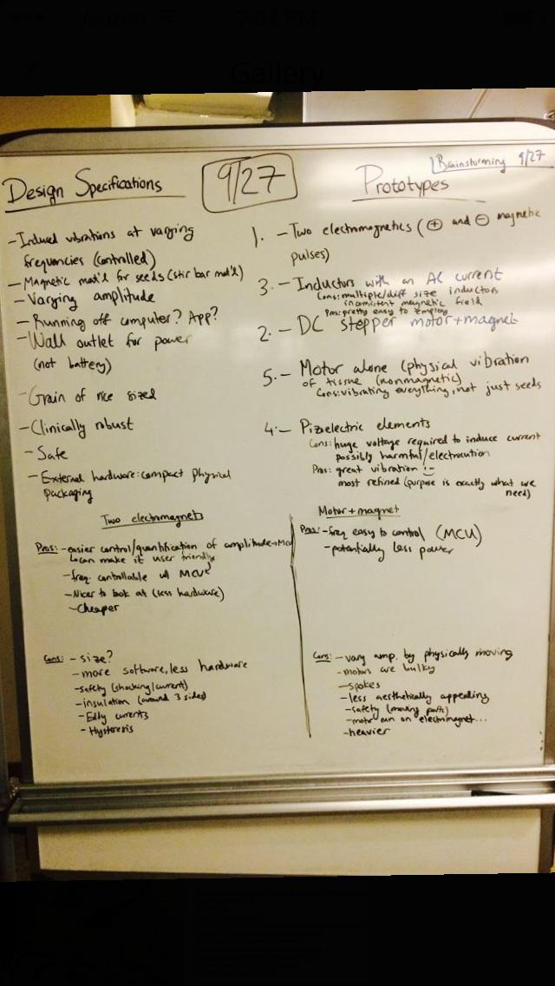
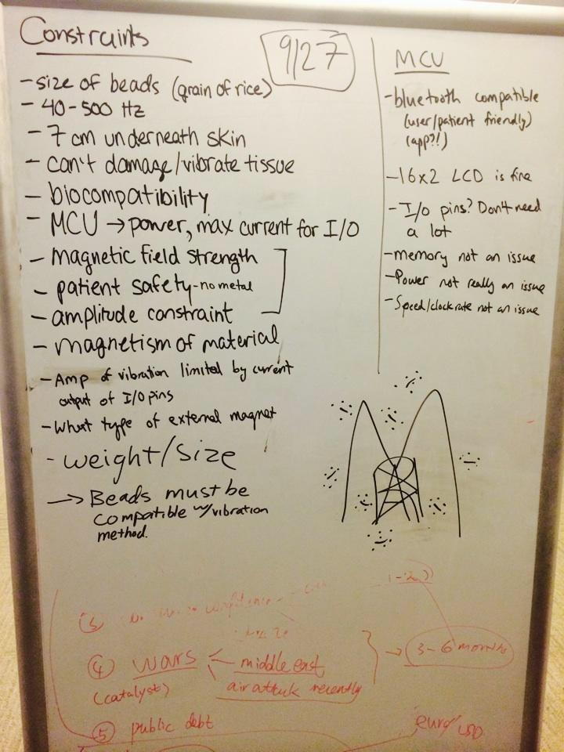
Brainstorming
Notes:
background research → design details → prototypes

Slide 6
Design Constraints
Size of beads
Frequency of vibration: 40-500 Hz
Depth (7 cm under skin)
Strength of vibration: amplitude restraint (damaging tissue)
MCU: Power, max current for I/O
Biocompatibility
Patient safety (no metal, magnetic field strength)
Amplitude limited by current output of I/O pins
External magnet type (strength, etc)
Overall weight and size
Beads must be compatible with vibration method

Slide 7
Design Specifications
Controlled, induced vibrations at varying frequencies
Controlled, induced, varying amplitude
Magnetic material for seeds (stir bar material, Polyether ether ketone)
Wall outlet for power
Size: grain of rice
Clinically robust
Safe: biocompatible, will not leak radiation, will not damage tissue, etc
External hardware: compact packaging
Running of computer or app?

Slide 8
Microcontroller
Bluetooth compatible (user/patient friendly)
Computer or app interface
16x2 LCD works well
I/O pins: do not need large number
Memory, power, and speed/clockrate are not issues
Choice: BeagleBone

Slide 9
Software License
Apache License Preferred
Open source, but companies can use the software in their own product
Potential for patent
If we used GPL license, anything we produce must also be open source
Notes:
any collaborators have to sign an Individual Contributor License Agreement with the company/owner - clearly defines intellectual property

Slide 10
Top 3 Prototypes
Inductors
Inductors store energy in the form of magnetic fields due to changes in their input current. Via an AC current input, an oscillating magnetic field can be produced
Pros | Cons
Pretty simple- easy to implement | 1 inductor = 1 amplitude setting → would need multiple inductors to achieve different amplitudes :(
Change Input Frequency = change magnetic field frequency | Low frequencies hard to attain - inductor transients are very short
 | Requires very large Inductors

Slide 11
Top 3 Prototypes
Bar magnet + Step Motor
A Step motor is used to physically oscillate a permanent bar magnet
Pros | Cons
Easy to control frequency Change motor speed = change frequency | Magnetic field amplitude not directly alterable → would have to be adjusted via distance
Relatively cheap and simple to build | Moving parts and large size which needs to be encased
Not much hardware required | Heavier

Slide 12
Top 3 Prototypes
1.Two electromagnets
Opposite polarity, pulsing out of phase with each other to create an oscillating magnetic field
Pros | Cons
Easy to adjust magnetic field amplitude More current = higher amplitude | Cannot be directly powered by microcontroller
Frequency of pulses controllable by microcontroller | Safety - need to insulate
More Software Based | Electromagnets (?)
No external parts to break or wear out

Slide 13
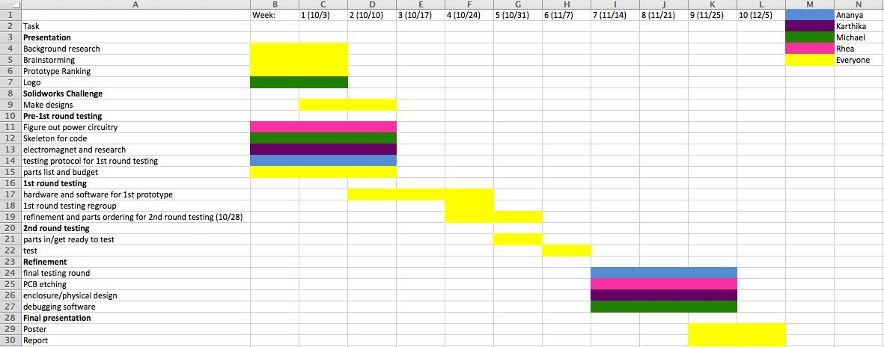
Gantt Chart

